Slide 1
Object Oriented Programming—C++ Lecture9 Template Functions
Qijun Zhao
College of Computer Science
Sichuan University
Spring 2023

Slide 2
Why do we want generic C++?
C++ is strongly typed, but generic C++ lets you parametrize data types!
● Ex. variable return type or input in a class (template classes)
Can we parametrize even more?
Can we write a function that works on any data type?

Slide 3
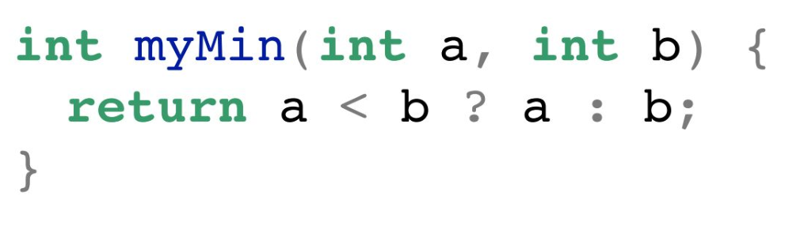
Why not!
Let’s say we want a function to return the min of two ints!
We take in two
ints…
And return an
int!
What about doubles? Floats? Longs?

Slide 4
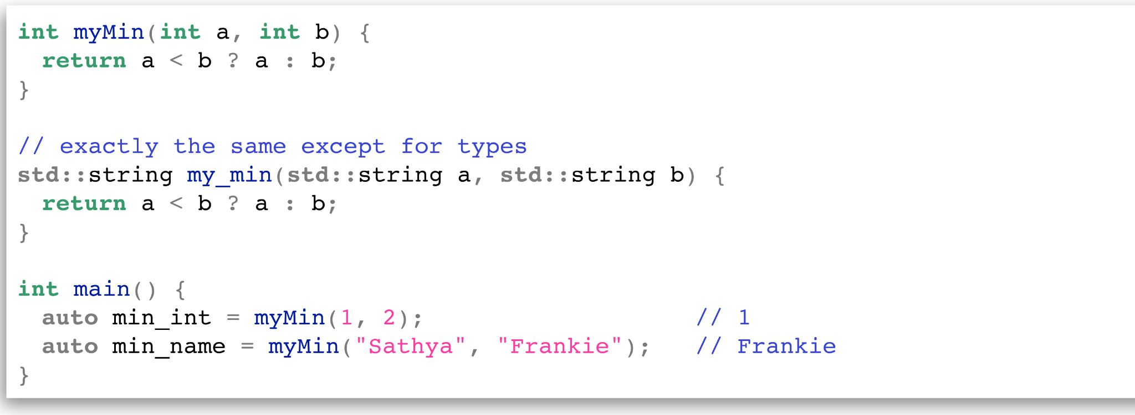
What about function overloading?
Sure, we
could…
What about
other types?

Slide 5
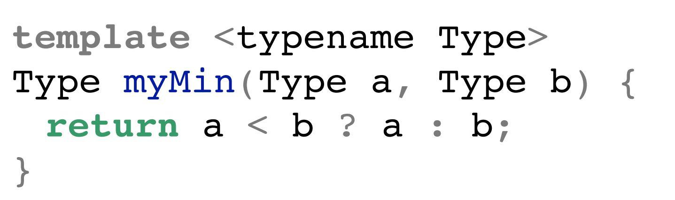
Template functions are completely generic functions!
Just like classes, they work regardless of type!
Let’s break it down:
Specifies that
Type is generic
List of your
template
variables
Indicating this
function is a template

Slide 6
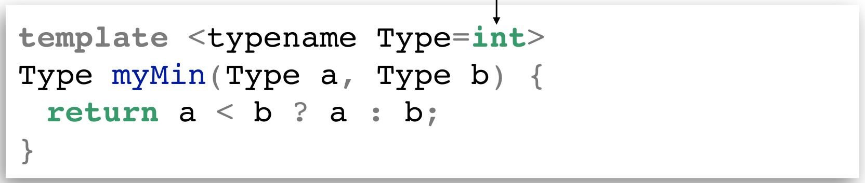
Default Types
We can define default parameter types!
What does it look like to use a template function?

Slide 7
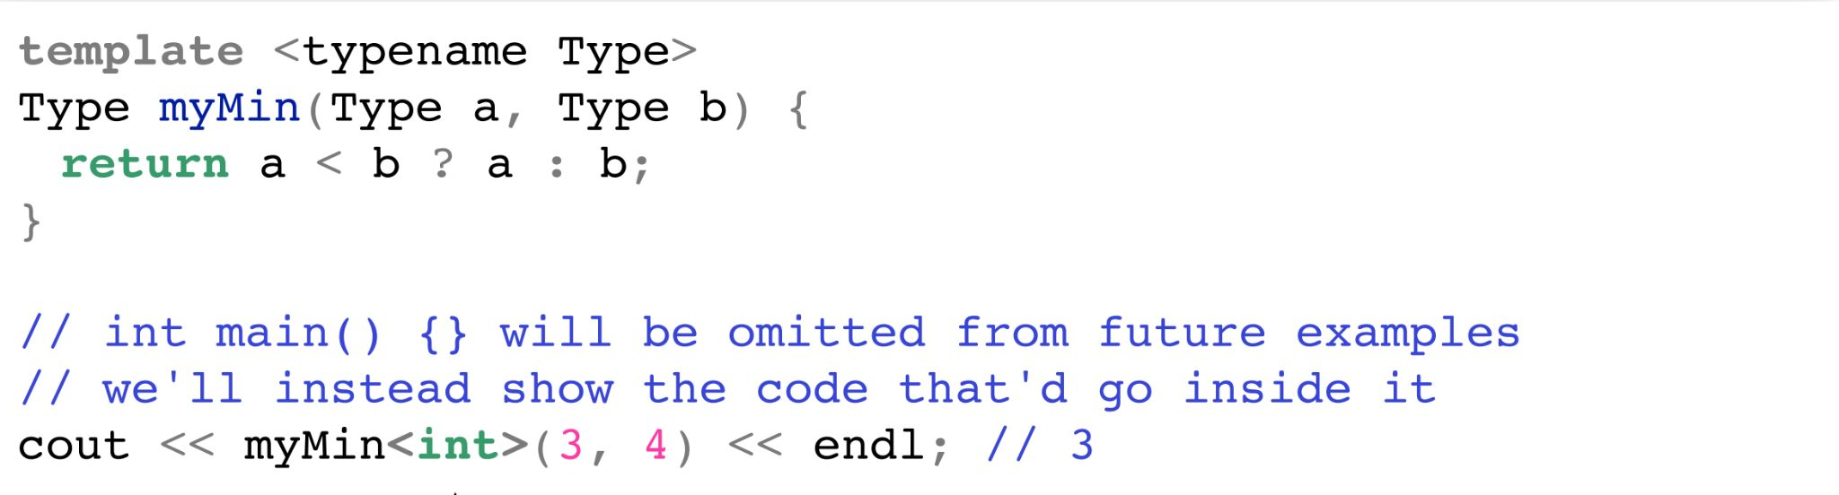
Calling template functions
We can explicitly define what type we will pass, like this:
Just like in
template classes!

Slide 8
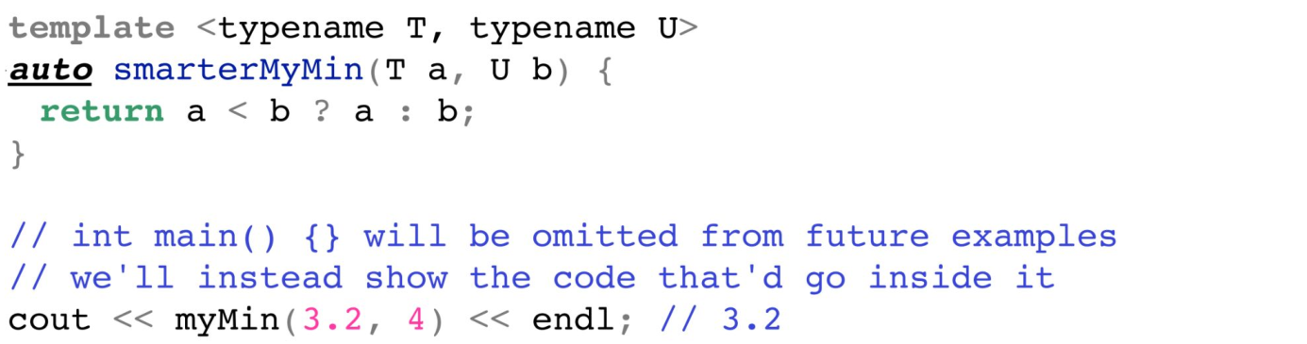
Calling template functions
We can also implicitly leave it for the compiler to deduce!

Slide 9
Behind the Instantiation Scenes
Remember: like in template classes, template functions are not compiled until used!
● For each instantiation with different parameters, the compiler generates a new specific version of your template
● After compilation, it will look like you wrote each version yourself

Slide 10

Wait a minute…
The code doesn’t exist until you instantiate it, which runs quicker.
Can we take advantage of this behavior?

Slide 11
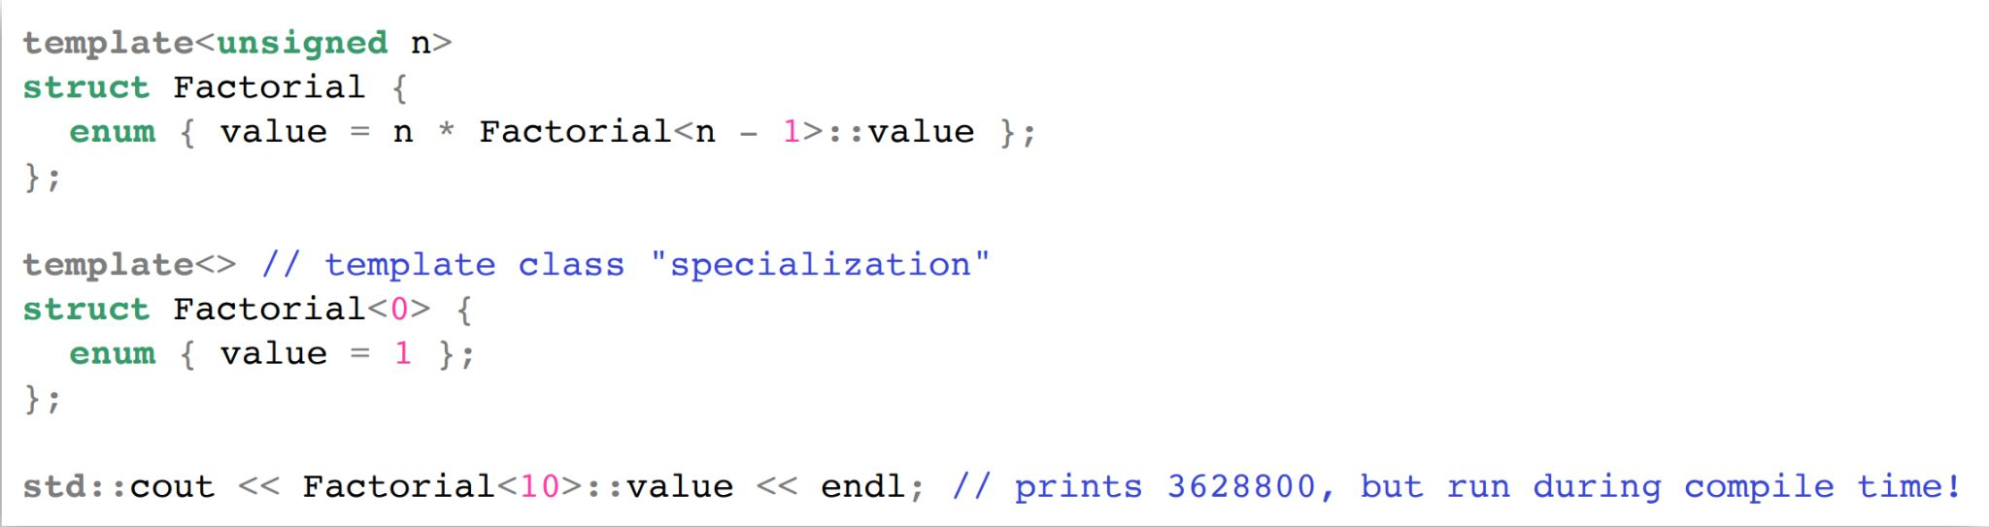
Templates can be used for efficiency!
Normally, code runs during runtime.
With template metaprogramming, code runs once during compile time!

Slide 12
How?

Slide 13
Why?
Overall, can increase performance for these pieces!
● Compiled code ends up being smaller
● Something runs once during compiling and can be
used as many times as you like during runtime
TMP was an accident; it was discovered, not invented!

Slide 14
Applications of TMP
TMP isn’t used that much, but it has some interesting implications:
● Optimizing matrices/trees/other mathematical structure operations
● Policy-based design
● Game graphics

Slide 15
Solving problems with generics
What if we wanted to count all the occurrences of a character in a string?
Or a number in a vector?
Or a word in a stream?
These are all the same problem!

Slide 16
Summary
● Template functions allow you to parametrize the type of a function to be anything without changing functionality
● Generic programming can solve a complicated conceptual problem for any specifics – powerful and flexible!
● Template code is instantiated at compile time;template metaprogramming takes advantage of this to run code at compile time

Slide 17
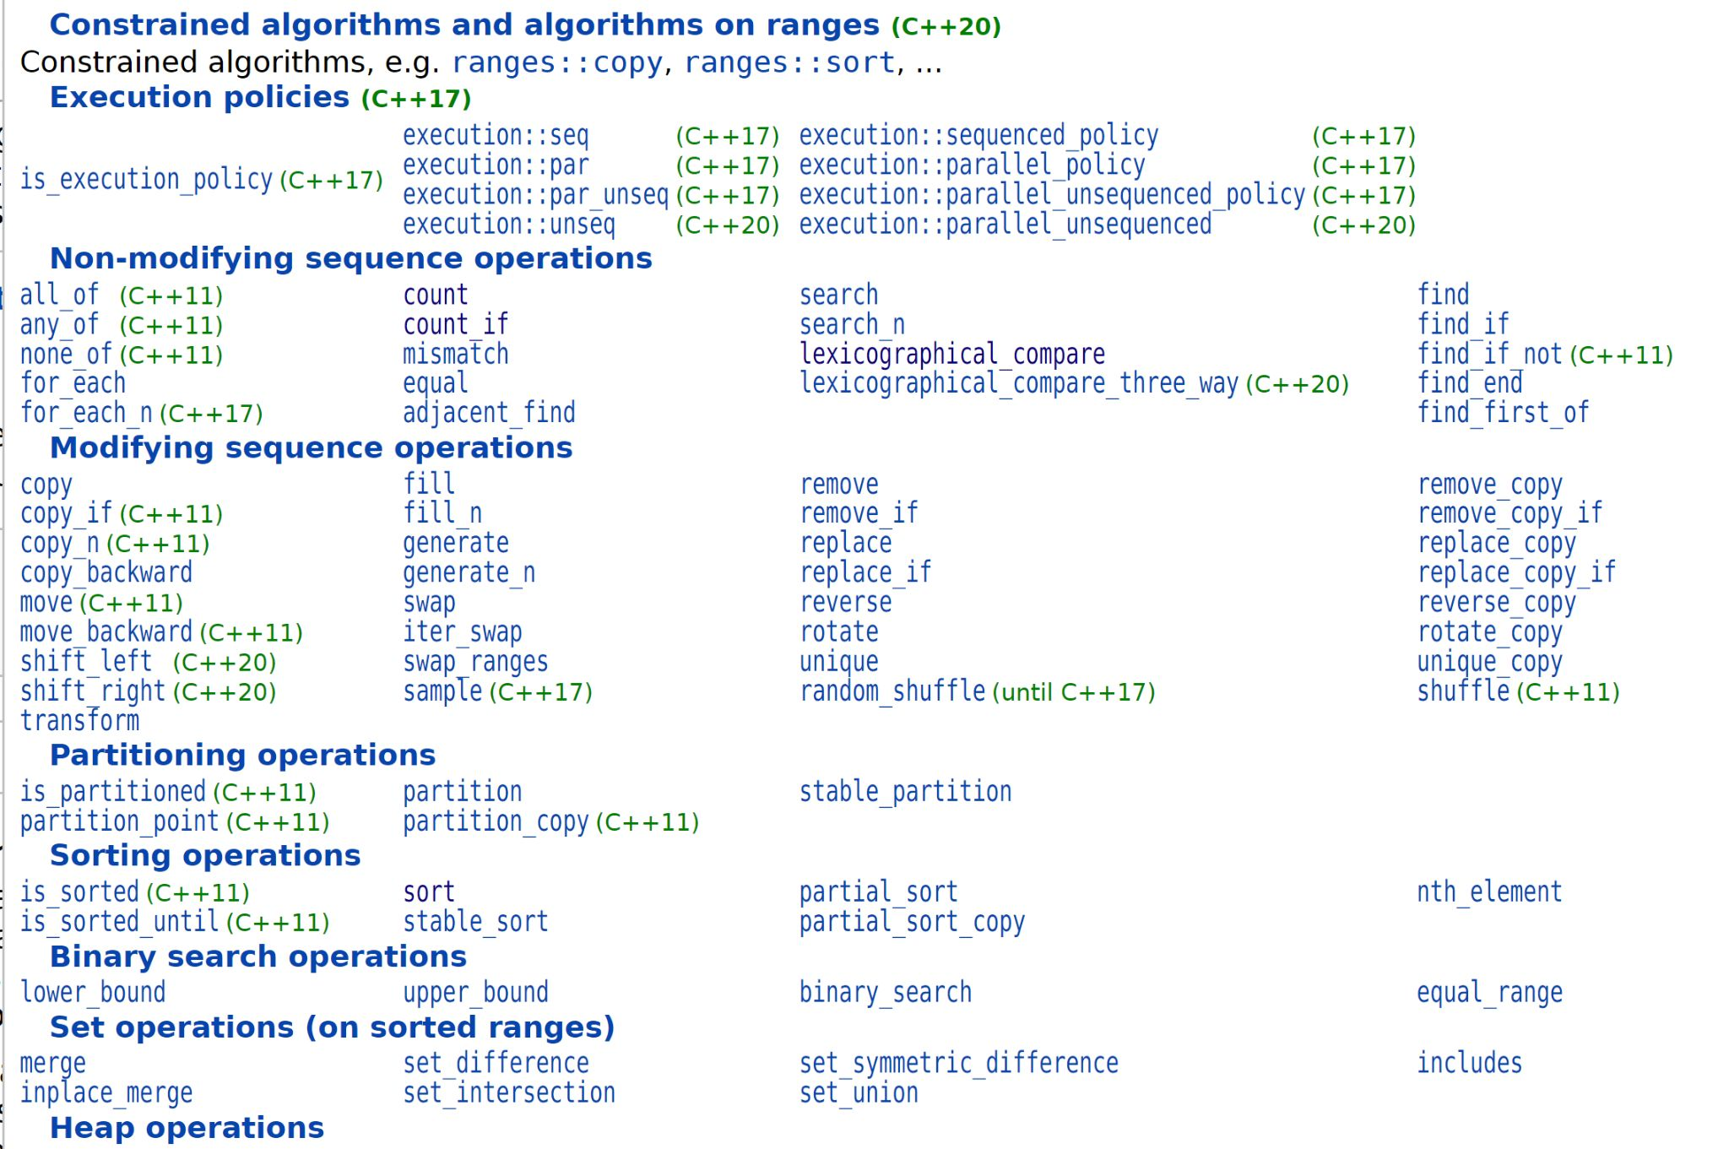
New toys!
The STL implements an entire library of algorithms
written by C++ developers!
● To utilize, #include <algorithm> in your file!
● All algorithms are fully generic, templated functions!

Slide 18
Look familiar?
count_occurrences
std::count_if

Slide 19
Algorithms
All standard algorithms work on iterators.
● Efficient searching, sorting, complex data structure
operations, smart pointers, and more are all there for
you to use!
● Check out the documentation to get more information!

Slide 20
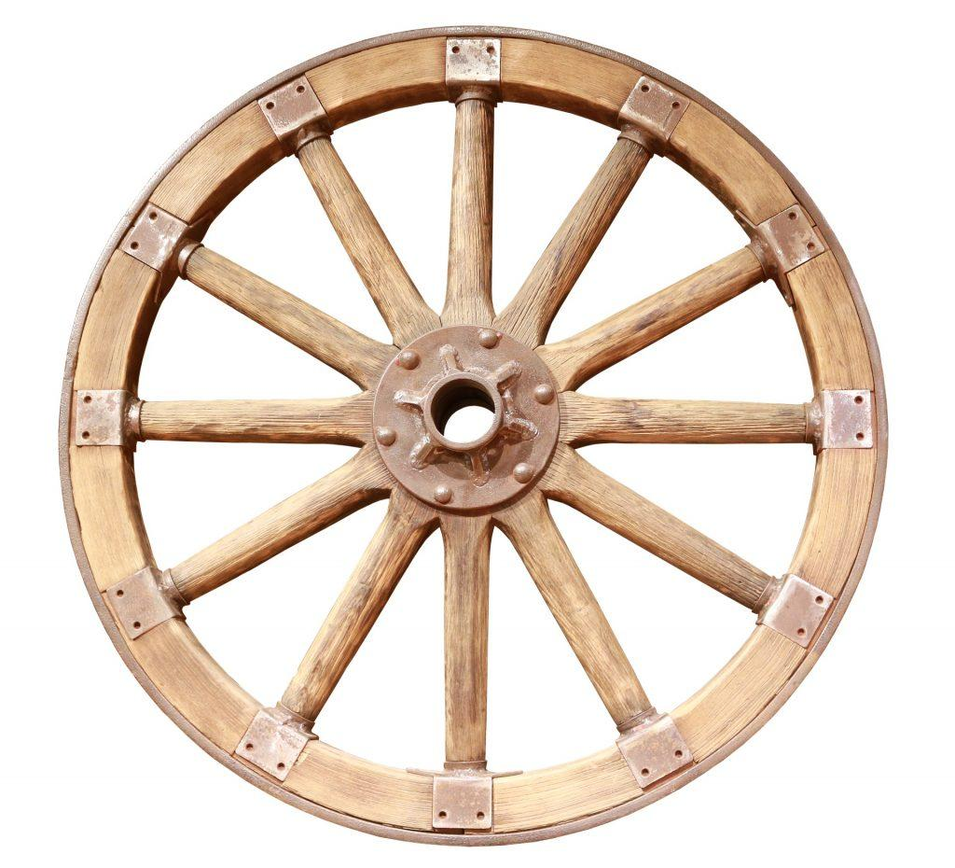


Coding Philosophy 101
There are few universal, scientifically proven
pieces of wisdom that will lead to a happier life:
1. Look both ways before crossing the street.
2. Never tell a pre-med you’re stressed.
3. When coding, never reinvent the wheel.

Slide 21
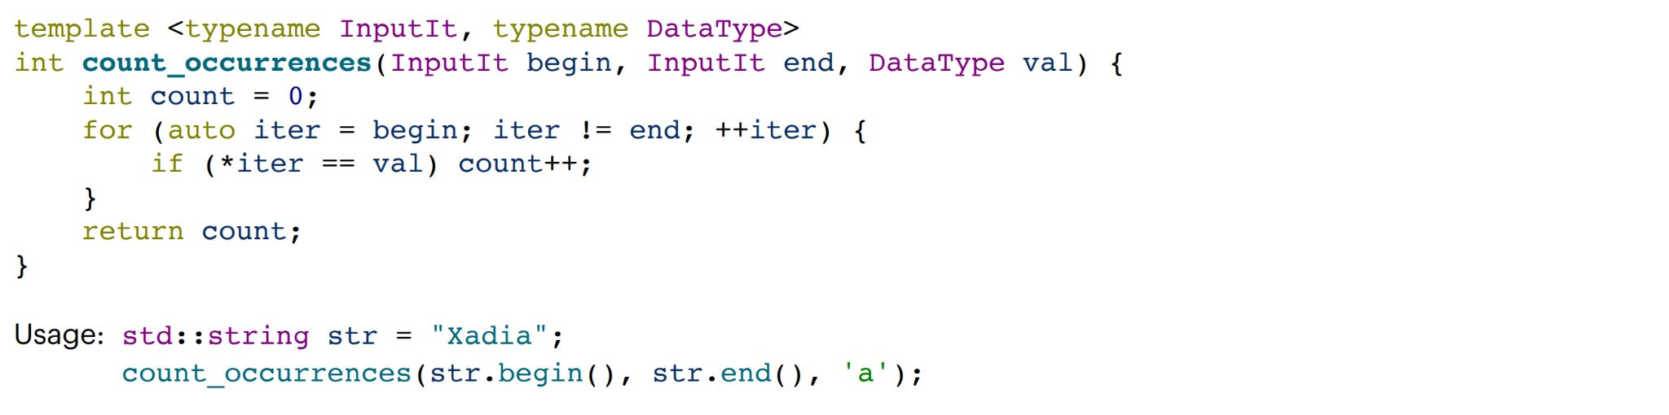
This is a successfully templated function!
This code will work for any containers with any types, for a single specific target.
Will this work for a more general category of targets than one specific value?
isVowel(*iter) ?
What if we wanted to find all the
vowels in “Xadia”?

Slide 22
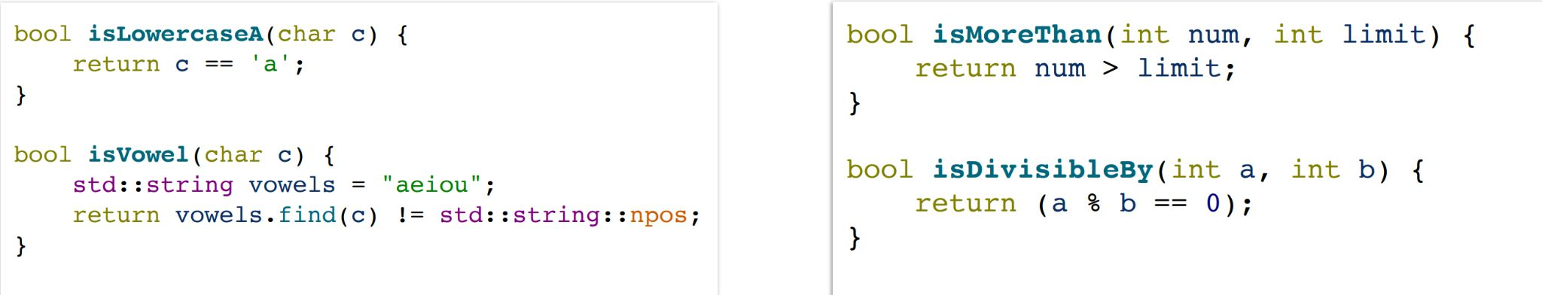
Predicate Functions
Any function that returns a boolean value is a predicate!
● isVowel() is an example of a predicate, but there are
tons of others we might want!
● A predicate can have any amount of parameters…
Unary
Binary

Slide 23
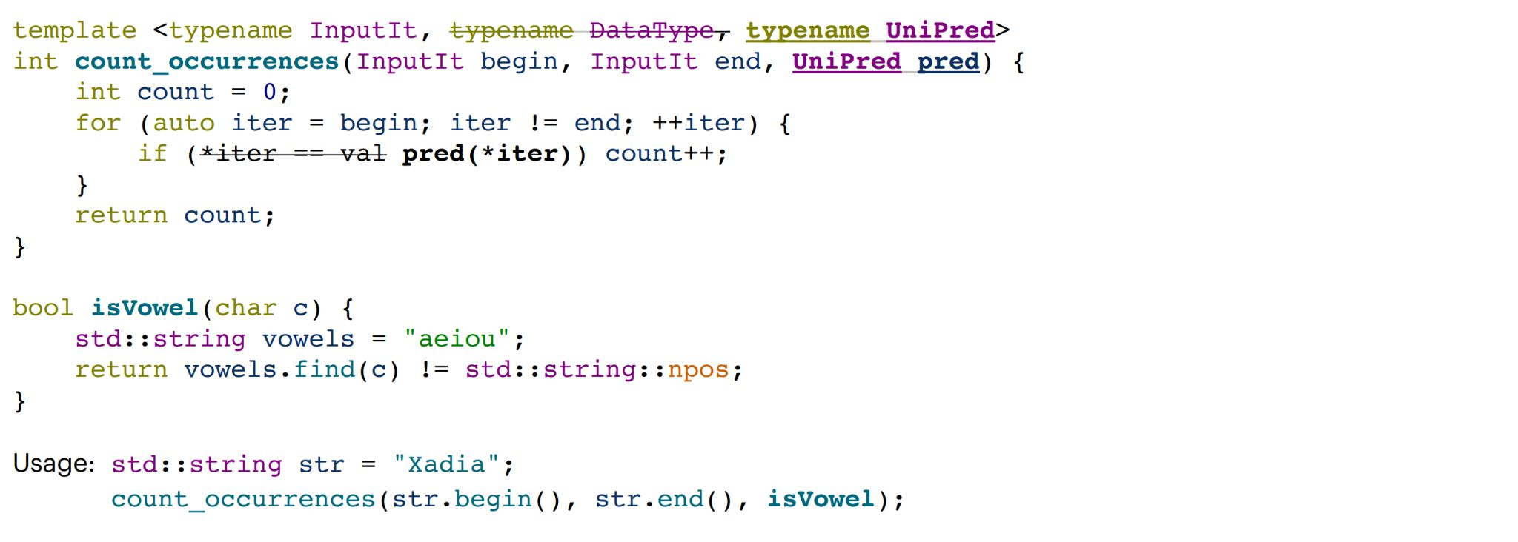
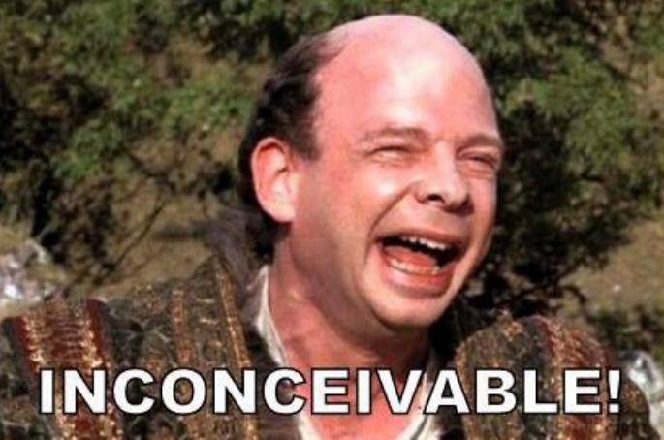
Let’s use that!
What type is UniPred???

Slide 24
Function Pointers
UniPred is what’s called a function pointer!
● Function pointers can be treated just like other pointers
● They can be passed around like variables as parameters or in template functions!
● They can be called like functions!

Slide 25
Is this good enough?
Are there any ways this could be an issue?

Slide 26
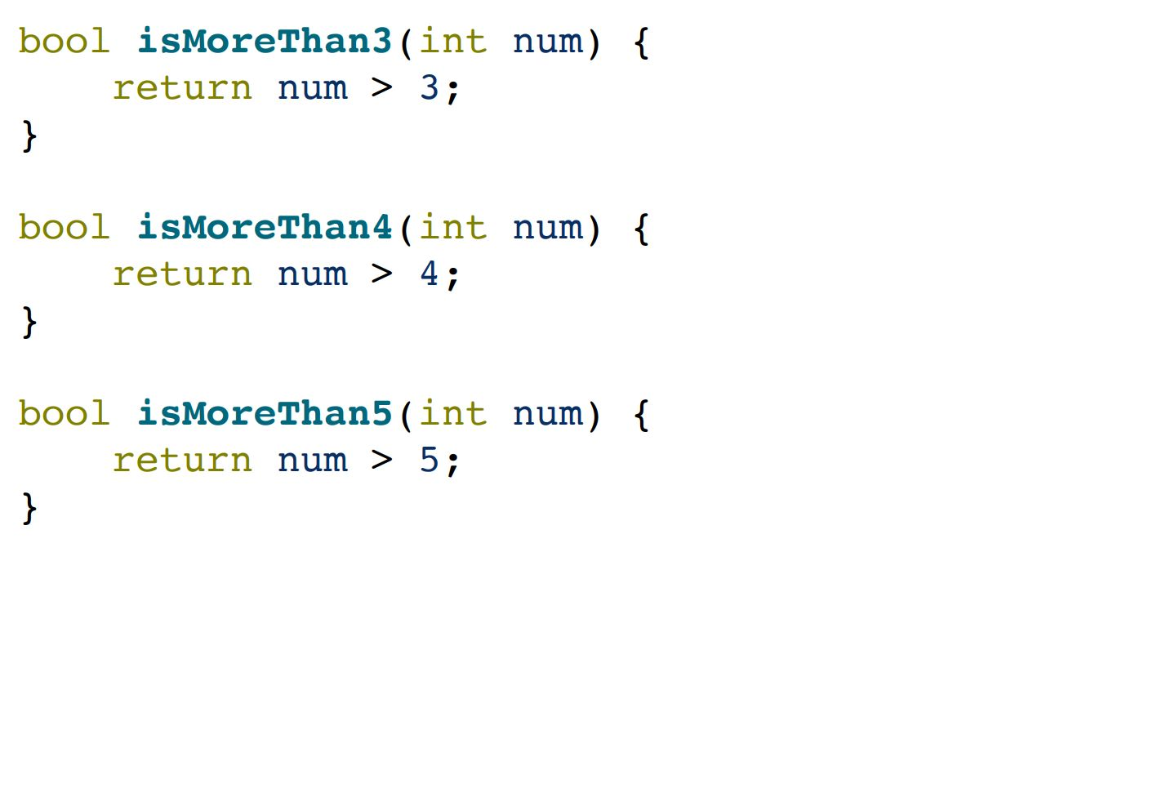
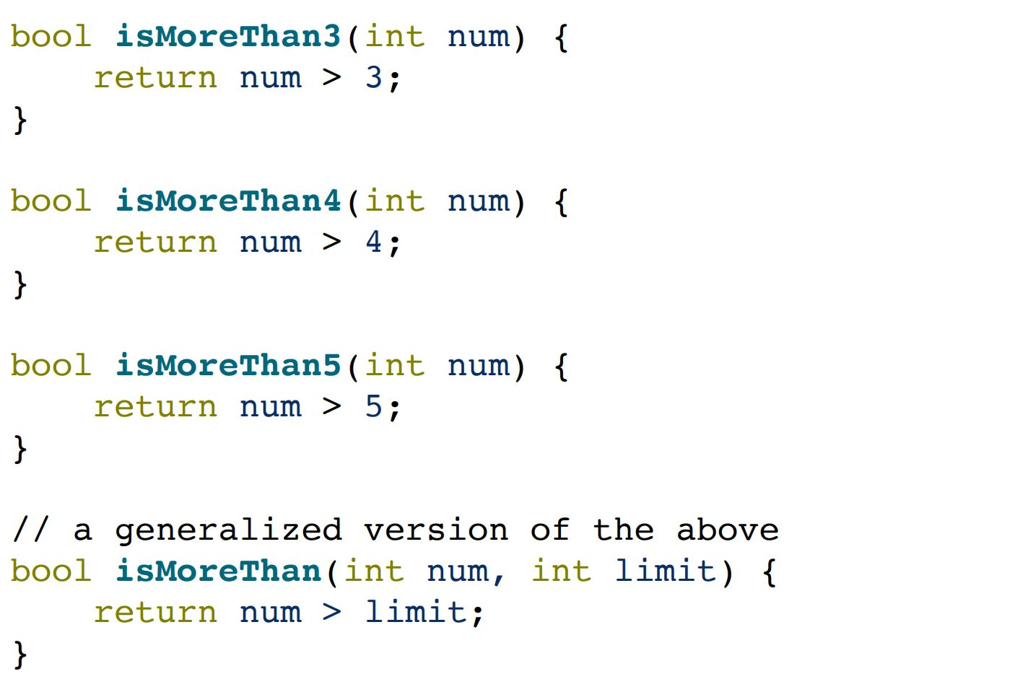
Poor Generalization
Unary predicates are pretty limited and don’t
generalize well.
Ideally, we’d like something like this!

Slide 27
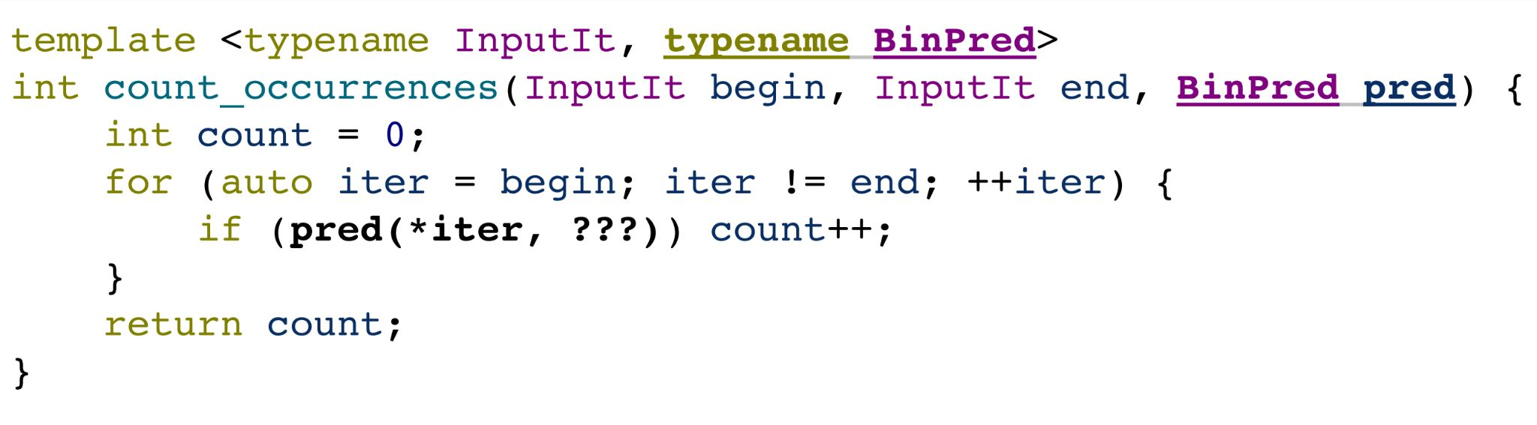
Can we use binary predicates?
If we could, it would be nice to use a binary predicate to handle this!

Slide 28
Can we use binary predicates?
How do we know what value to use? What about unary (or any other number of arguments) predicates?
We can’t pass this in from
the predicate!

Slide 29
The Catch-22
We want our function to know more information about our predicate.
However, we can’t pass in more than one parameter.
How can we pass along information without needing another parameter?

Slide 30
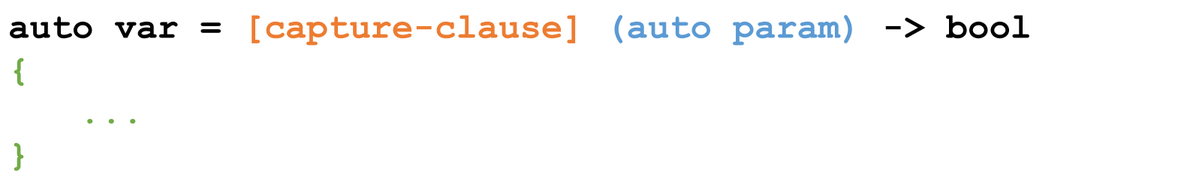
Let’s use lambdas!
Lambdas are inline, anonymous functions that can know about functions declared in their same scope!

Slide 31
Let’s use lambdas!
Lambdas are inline, anonymous functions that can know about functions declared in their same scope!

Slide 32
Let’s use lambdas!
Lambdas are inline, anonymous functions that can know about functions declared in their same scope!

Slide 33
Let’s use lambdas!
Lambdas are inline, anonymous functions that can know about functions declared in their same scope!
Outside parameters
go here
Specifies that
Type is generic
Function body
goes here!

Slide 34
Let’s use lambdas!
It might look something like this!

Slide 35
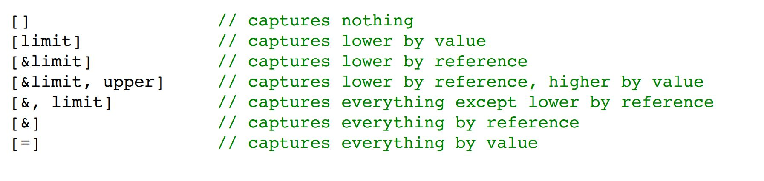
Capture Clauses
You can capture any outside variable, both by reference and by value.
● Use just the = symbol to capture everything by value,
and just the & symbol to capture everything by
reference

Slide 36
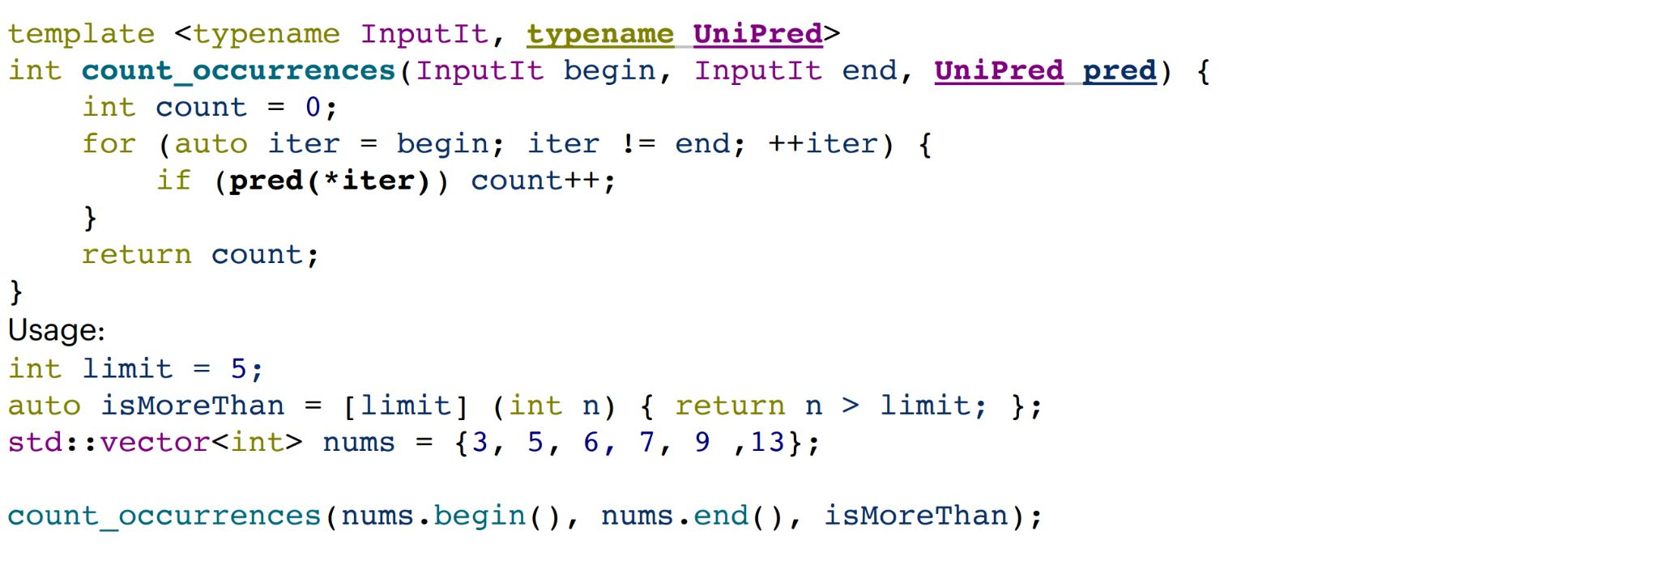
We’ve solved our problem!

Slide 37
Using Lambdas
Lambdas are pretty computationally cheap and a great tool!
● Use a lambda when you need a short function or to
access local variables in your function.
● If you need more logic or overloading, use function
pointers.

Slide 38
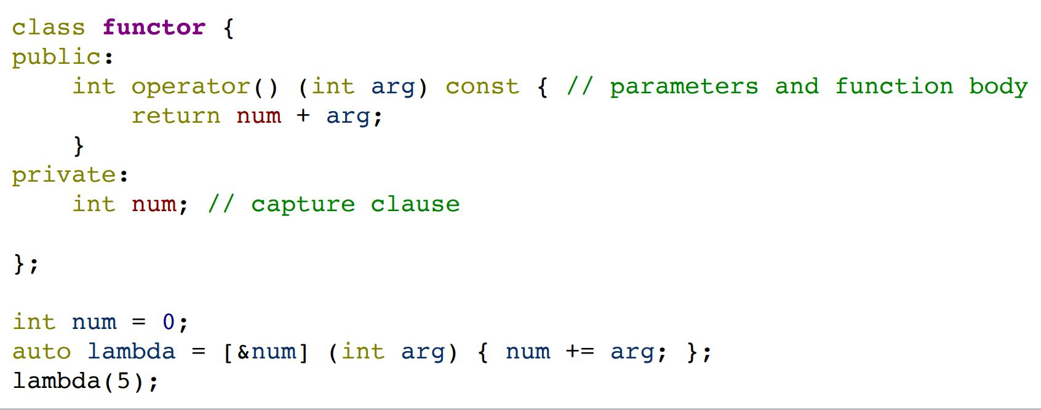
Aside: What the Functor?
A functor is any class that
provides an implementation of
operator().
● They can create closures
of “customized”functions!
● Lambdas are just a reskin
of functors!
Closure: a single instantiation of a functor object

Slide 39
Tying it all together
So far, we’ve talked about lambdas, functors, and function pointers.
The STL has an overarching, standard function object!
std::function<return_type(param_types)> func;
Everything (lambdas, functors, function pointers) can be cast to a standard function!
Much bigger and more expensive than a
function pointer or lambda!

Slide 40
Summary
● Lambda functions are inline functions that let you
pass outside variables in using capture clauses!
● Lambdas can be used to pass predicate function
pointers to template functions for more
generalizability.
● The STL implements tons of cool alg

Slide 41
Coding for love, Coding for the world
Qijun Zhao
qjzhao@scu.edu.cn

